Slide 1

Cyber Security Portal for Effective Management of Servers and Firewalls
Under the Guidance of:
Mr P.Siva
(Assistant Professor)
Team Members:
P. Sree Raag(1608-21-733-099)
M. Regenald(1608-21-733-120)
Sk.Shoyaib(1608-21-733-129)

Slide 2
Content:
Abstract
Objective & Problem Statement
System Requirement Specification
Existing System & Proposed System
Architecture / System Design
Conclusion
References
Question and Answer

Slide 3
Abstract
The project aims to develop a web-based management system for IT infrastructure. It includes features like user authentication, server administration, firewall rule management, hardware inventory, provisioning requests, monitoring, and load balancer management. Technologies used include Flask, Jinja2, and various databases. Future plans include real system integration, advanced monitoring, automated provisioning, and improved security measures.

Slide 4
Objectives:
Develop a secure web-based management system for server administration and IT infrastructure management.
Implement features for user authentication, server management, firewall rule management, and hardware inventory.
Provide real-time monitoring and reporting capabilities.
Administer provisioning requests and load balancer management.
Ensure the system is scalable and prepared for future enhancements.

Slide 5
Problem Statements:
The need for a centralized system to manage various aspects of IT infrastructure efficiently.
Ensuring secure user authentication and authorization to differentiate between admin and regular users.
Handling dynamic server management tasks, including adding, deleting, and displaying server details.
Managing firewall rules effectively and securely.
Addressing provisioning requests for new servers and hardware inventory management.

Slide 6
System Requirements:
Hardware Requirements: Processor:
Intel Core i5 or AMD Ryzen 5 (Quad-Core)
RAM: 8 GB minimum (16 GB recommended)
Storage: 256 GB SSD
Operating System: Windows 10/11, macOS, or Linux
Graphics: Integrated or basic discrete GPU
Network: High-speed internet connection
Software Requirements: Processor:
The front-end is built using HTML, CSS, with a responsive design for seamless access on various devices.
For the back-end, we utilize Python and the Django framework, ensuring scalability and maintainability

Slide 7
Existing System
A centralized dashboard providing real-time monitoring and management of server activities and firewall configurations.
Automated threat detection algorithms to identify and mitigate potential security breaches promptly.

Slide 8
Proposed System
⮚ Server Management(Add , View , Delete)
⮚ Firewall Rule Management(Add , View ,Delete)
⮚ User Authentication And Authorization( User
login, Admin login, User Registration)
⮚ Security Management(Role Based Access
Control, Password Hashing)
⮚ User Interaction(User-Friendly Interface,
Flash Messages)
⮚ Logging And Tracking(Audit Trails)
⮚ System Administration(System Maintenance)

Slide 9
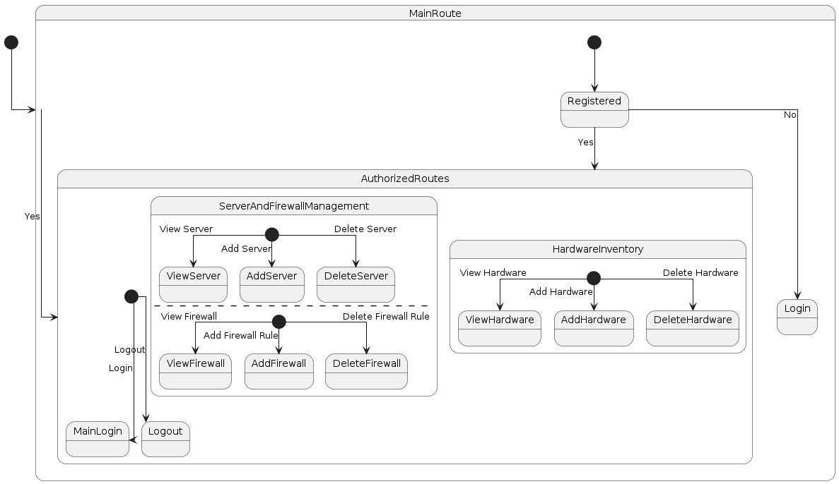
Architecture / System Design

Slide 10
Conclusion
The project provides a centralized, secure management system for IT infrastructure. Key features include user authentication, server and firewall management, hardware inventory, and real-time monitoring, enhancing administrative efficiency and security. Planned enhancements include system integration, advanced monitoring, automated provisioning, and scalability, laying a robust foundation for ongoing improvements in IT infrastructure management and security.

Slide 11
References
Google and ChatGPT
https://www.irjmets.com/uploadedfiles/paper//issue_4_april_2024/53779/final/fin_irjmets1713953959 (Fully Refereed International Journal)
From GitHub

Slide 12
Any Questions.

Slide 13
Thank you

